Slide 1
COVID CASES in TEXAS and Infection Rate – predicting end of the pandemic
Abhijat goyal

Slide 2
Introduction
Whole world is suffering from COVID pandemic.
Everybody wants to know when this might end.
Question:
can we use machine learning to study and possibly predict when this will end,
or at least,
the direction in which this pandemic is going.

Slide 3
Technical Background
The number of new cases per day can be associated with the infection rate.
The infection rate is called as Basic Reproduction Number, R_{0,} which is a static parameter.
To monitor the rate of infection daily, we need to monitor it daily.
The dynamic infection rate is called as Rt, which can be calculated on a dynamic basis.
We need to use Bayesian statistic to calculate the value of Rt.

Slide 4
Bayesian Statistic to calculate Rt
𝑃(𝑅𝑡|𝑘)=𝑃(𝑘|𝑅𝑡)⋅𝑃(𝑅𝑡) / 𝑃(k)
Where, the likelihood of seeing 𝑘 new cases given 𝑅𝑡 times ...
The prior beliefs of the value of 𝑃(𝑅𝑡) without the data ...
divided by the probability of seeing this many cases in general.
This is for a single day. To make it iterative: every day that passes, we use yesterday's prior 𝑃(𝑅𝑡−1) to estimate today's prior 𝑃(𝑅𝑡). We will assume the distribution of 𝑅𝑡 to be a Gaussian centered around 𝑅𝑡−1 so 𝑃(𝑅𝑡|𝑅𝑡−1)=N(𝑅𝑡−1,𝜎), where 𝜎 is a hyperparameter (see below on how we estimate 𝜎). So, on day one:
𝑃(𝑅1|𝑘1) ∝ 𝑃(𝑅1)⋅L(𝑅1|𝑘1)
On day two:
𝑃(𝑅2|𝑘1,𝑘2) ∝ 𝑃(𝑅2)⋅L(𝑅2|𝑘2) = ∑𝑅1𝑃(𝑅1|𝑘1)⋅𝑃(𝑅2|𝑅1)⋅L(𝑅2|𝑘2)

Slide 5
Bayesian Statistic to calculate Rt
The first step is to model the 'arrival' process of infections. A popular choice for the distribution of arrivals amongst statisticians is the Poisson Distribution. Accordingly, if we let λ represent the average rate of infections per day, then the probability that we are likely to see k new cases on a day, is given by
𝑃(𝑘|λ)=[λ𝑘𝑒xp(−λ)] / 𝑘!
Given this setup, we can construct the probability distribution of new cases for a set of λ's.

Slide 6
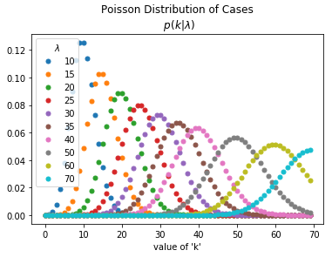
Honing the algorithm on homogenized data
The data shows distribution for each k and lambda.
The spead of the curves shows the uncertainty in the predicted value of Rt.
We need to tie this into lambda.
The spread is different for different values of lambda.

Slide 7
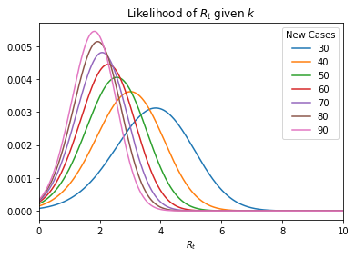
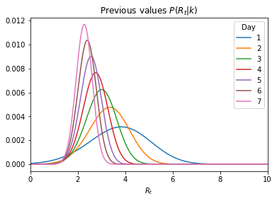
Previous and current value of Rt
We have calculated the current value of Rt based on the previous value of Rt and lambda.

Slide 8
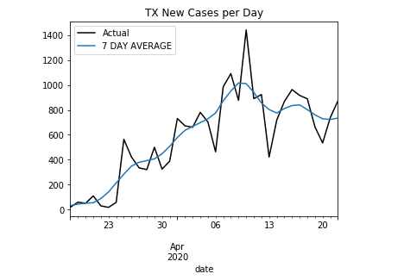
Modelling on data from Texas
Data obtained from
https://covidtracking.com/api/v1/states/daily.csv
7 day rolling average added to the data so that we can deal with less noise. In presence of excessive noise, the predictive algorithm might not converge.
We will use this data to predict the infectivity of the disease, and provide insight into trends and hence possible predict the future and end of this epidemic.

Slide 9
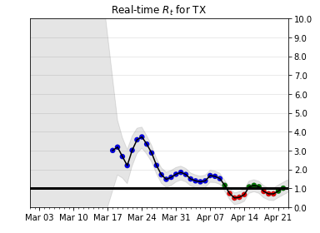
Infectivity graph over time for texas
As we can see from this graph of Rt over time, the infection rate is decreasing.
There was a dip in infection rate below 1 around April 10.
But since then, the infectivity has been bouncing around 1.
A consistent value less than 1 is required to make sure that this epidemic will die down.
The lower the value of Rt below 1, the sooner will the epidemic end.
Since we are still wobbling around 1 in Texas, I think that this epidemic still has legs and will continue to affect our daily lives until Rt goes way below 1.

Slide 10
Conclusions
The data on Rt showed in the previous slide can be used by businesses to –
Determine how long the disease will persist
How long businesses have to actively manage their supply chains wrt. pandemic
When will the customer demand be back (of course it is linked to end of pandemic).
How to model the revenues and hence the orders given the timeline of the pandemic.
Businesses can use this modelling to manage inventories and predict future demand.

